Slide 1

snake and ladder
Welcome to our game

Slide 2
What made us choose snake and ladder?
it reminds us of our childhood
Emotion regulation
Losing
Interact with others
Observing the rules

Slide 3
The general guidelines for our game
1. After selecting a piece of equipment, each player positions it on the initial square.
2. Roll a die to see who goes first. Go-first is the player with the highest rolling number.
3. The player advances their piece to the spaces indicated by rolling the dice during their turn.
4. If a player touches down on a square that has a ladder at its base, their piece ascends to the top of the ladder.
5. A player's piece descends to the snake's base if they lands on a square with a snake at its head.
6. When a piece of a different player lands on a square that another player has already taken up, that player's piece is knocked back to the beginning square.
7. The winner of the game is the first person to reach the 100th tile.
8. A player's piece stays in its current location if they roll a number that would move it past the 100th square.
9. The piece that was moved last stays on the square if a player lands on a spot already occupied by that player's other piece.

Slide 4
What are the special features in our game?
Some of our extra feature which provides a better experience for the user are:
The drop-down menu.
Different game modes: (player vs. player) and (player vs. pc).
Different difficulty levels: (easy and hard).
Background in the game.
Progress bar.
Output massage with stickers with the random function when climbing the ladder and when sliding down the snake.
The player can’t roll the dice twice except if he gets 6.
If the player rolls the dice and gets six, he will be asked to roll it again, and if he got six the third time he won’t play.
At any time the user can exit the game,replay, or even to start new game.

Slide 5
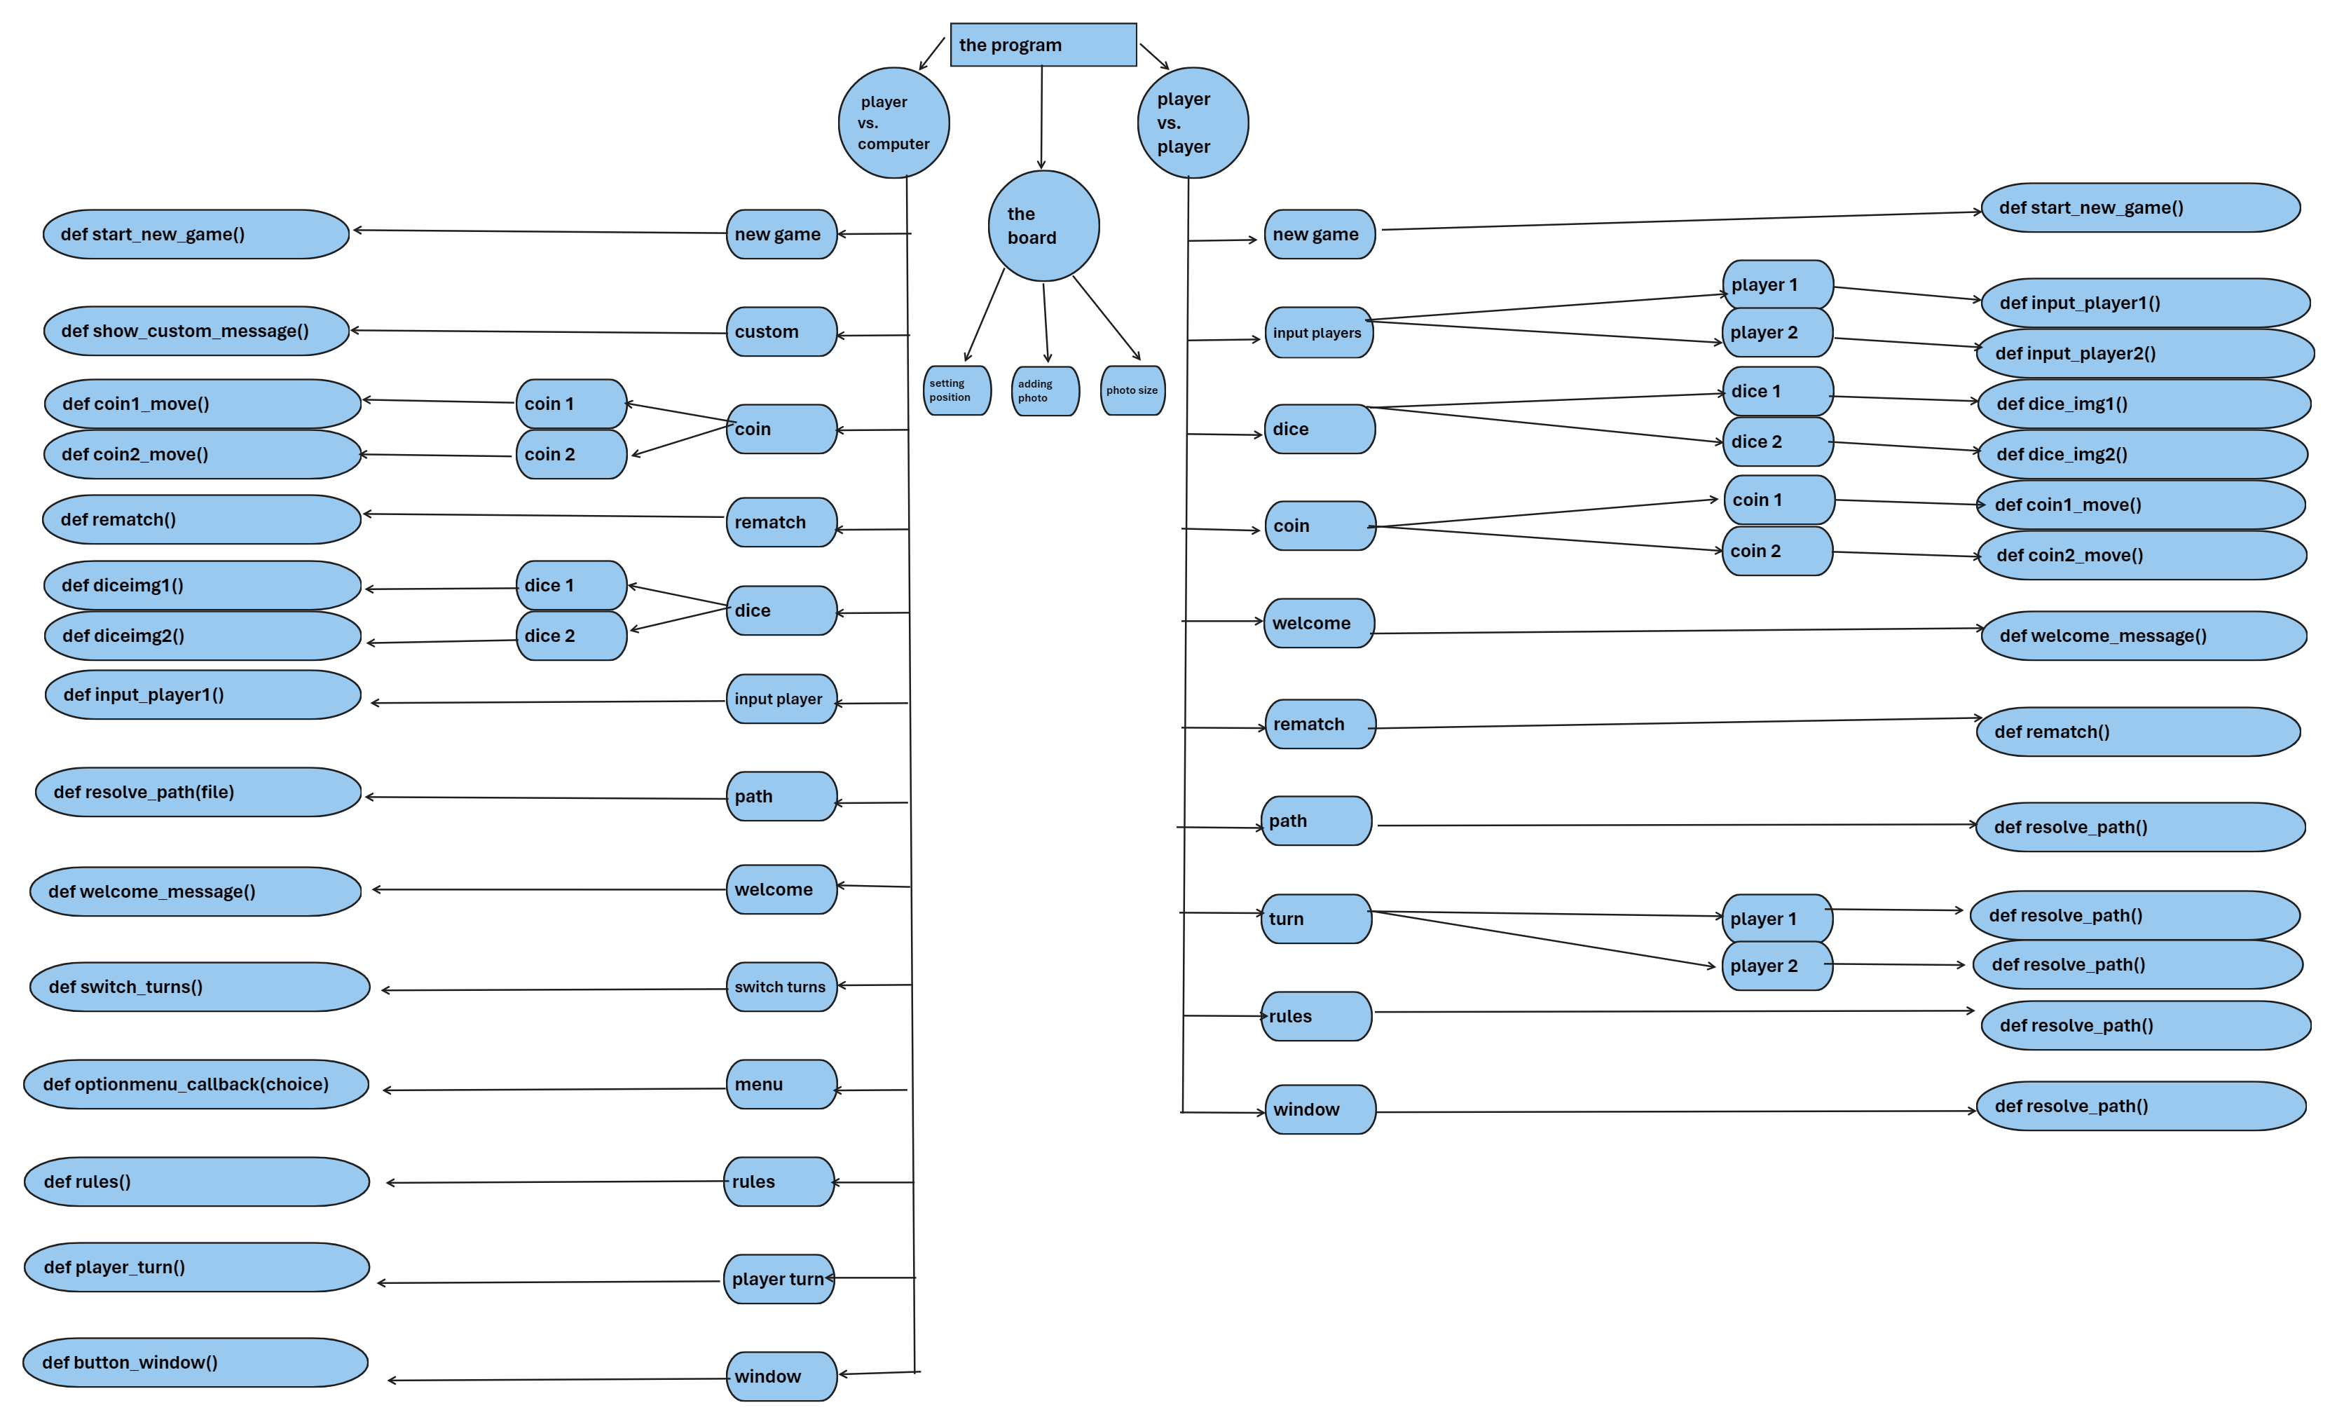
The hierarchy table

Slide 6
The general theory behind our code:
First we started by importing libraries and we used the graphic user interface Tkinter and customTkinter.
we set up the dimensions of the game
The board was initialized with some coordinates
For each of the difficulty levels we created 2 dictionaries one for the snakes and the other for the ladders
We created 2 coins with an initial position for each player with fixed steps on the x and y-axis.
We allowed the user to input the player name through buttons
We created a dice that produced random numbers between 1 and 6 with the random function
If the player has stepped on a ladder a display message will be printed with congrats the user for climbing on a ladder with a happy sticker, whereas if the player has stepped on the snake’s head a display message will be printed that tells the player that he has stepped on a ladder with sad sticker then returns the player to the tail of the snake.
A progress bar will show the probability of the winning player and that is measured by the first player that reaches the 100th square.

Slide 7
Our future goals and improvements:
Add music in the game with the volume button and mute button.
allow the user to choose the color and the template that he wants.
Create animations and gifs inside the game.

Slide 8
How our team has managed the tasks successfully?
Maroska Osama: | Youssef Ihab:
Snake and ladders Design and user interface User input | Saving and loading the game Dice functions Player turns
Omar Mohamed: | Hamdy El Saeed:
Coin movement Progress bar Message boxes | Buttons Drop-down menu with different functions Position dictionary

Slide 9
Thank you!! Hope you enjoyed our project ☺
Our team:
Maroska Osama 23-101209
Omar Mohamed 23-101149
Youssef Ihab 23-101138
Hamdy El Saeed 23-101232

